Slide 1

MICRO PROJECT OF GRAPHIC ENGINEERING (EGE 22003) NAME OF STUDENT ROLL NO 1. Abdurrahman QURESHI 210451 2. ANSARI SAAD MOHD. ARIF 210453 3. MORE ARYA LAXMAN 210460 4. ADNAN WASIM KAZI 210463 UNDER THE GUIDENCE OF LECTURER ZIAUDDIN SHAIKH LECTURER. PRINCIPAL/HOD: ZIAUDDIN SHAIKH ZAIBUNNISA MALIK

Slide 2
Topic: 3d isometric model
Aim: report on isometric model
Branch: computer engineering
Guide teacher: Mr. ziauddin sir
Students involved:
210451: Abdurrahman qureshi
210453: ANSARI SAAD MOHD. ARIF
210460: more arya laxman
210463: adnan kazi wasim

Slide 3
I master Abdurrahman Qureshi studying in first year computer engineering. My roll no. is 210451 would like to present my micro-project on “3d isometric” for the subject of engineering graphics.
Following are my group members:
210453: ANSARI SAAD MOHD. ARIF
210460: more arya laxman
210463: adnan kazi wasim
I express my share of gratitude to our guide mr. ziauddin sir for guiding me throughout this project.

Slide 4
rationale
Isometric projection : Isometric projection is a method for visually representing three-dimensional objects in two dimensions in technical and engineering drawings. It is an axonometric projection in which the three coordinate axes appear equally foreshortened and the angle between any two of them is 120 degrees.
The term “isometric” comes from the Greek for “equal measure”, reflecting that the scale along each axis of the projection is the same (unlike some other forms of graphical projection).

Slide 5
rationale
An isometric view of an object can be obtained by choosing the viewing direction such that the angles between the projections of the x, y, and z axes are all the same, or 120°. For example, with a cube, this is done by first looking straight towards one face. Next, the cube is rotated ±45° about the vertical axis, followed by a rotation of approximately 35.264° (precisely arcsin 1⁄√3 or arctan 1⁄√2, which is related to the Magic angle) about the horizontal axis. Note that with the cube (see image) the perimeter of the resulting 2D drawing is a perfect regular hexagon.

Slide 6
Actual Methodology Follow
Me and my team members has put a lot of efforts and gave our best to make this project more creative and attractive.
In our team we are four members adnan, arya, saad, and me.
We had divided the work into 2 parts . Me and saad decided to make a report and adnan and arya decided to make a 3D model.
For making model we have used cardboards, and cello tape.
and for report we had used word app . We had collected ball the information regarding 3d Isometric Model in it .

Slide 7
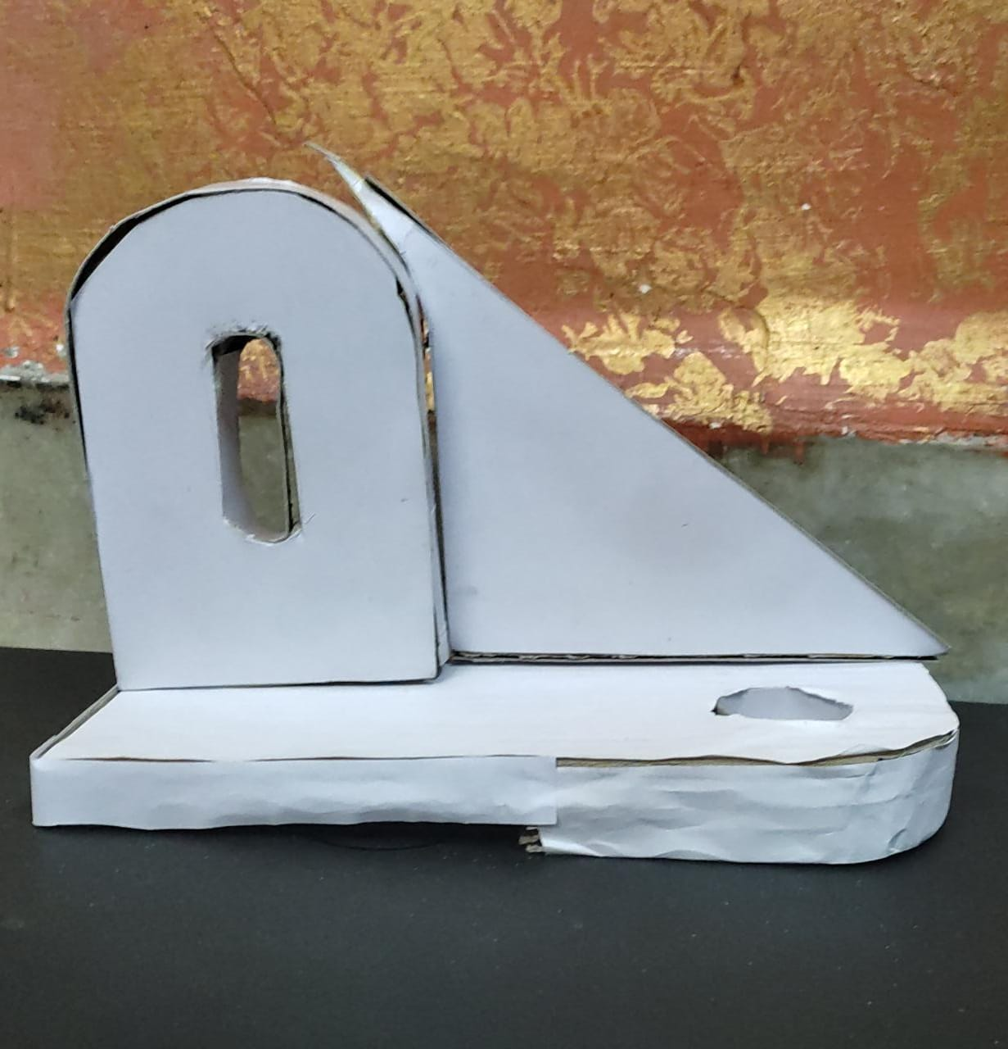
FRONT VIEW

Slide 8
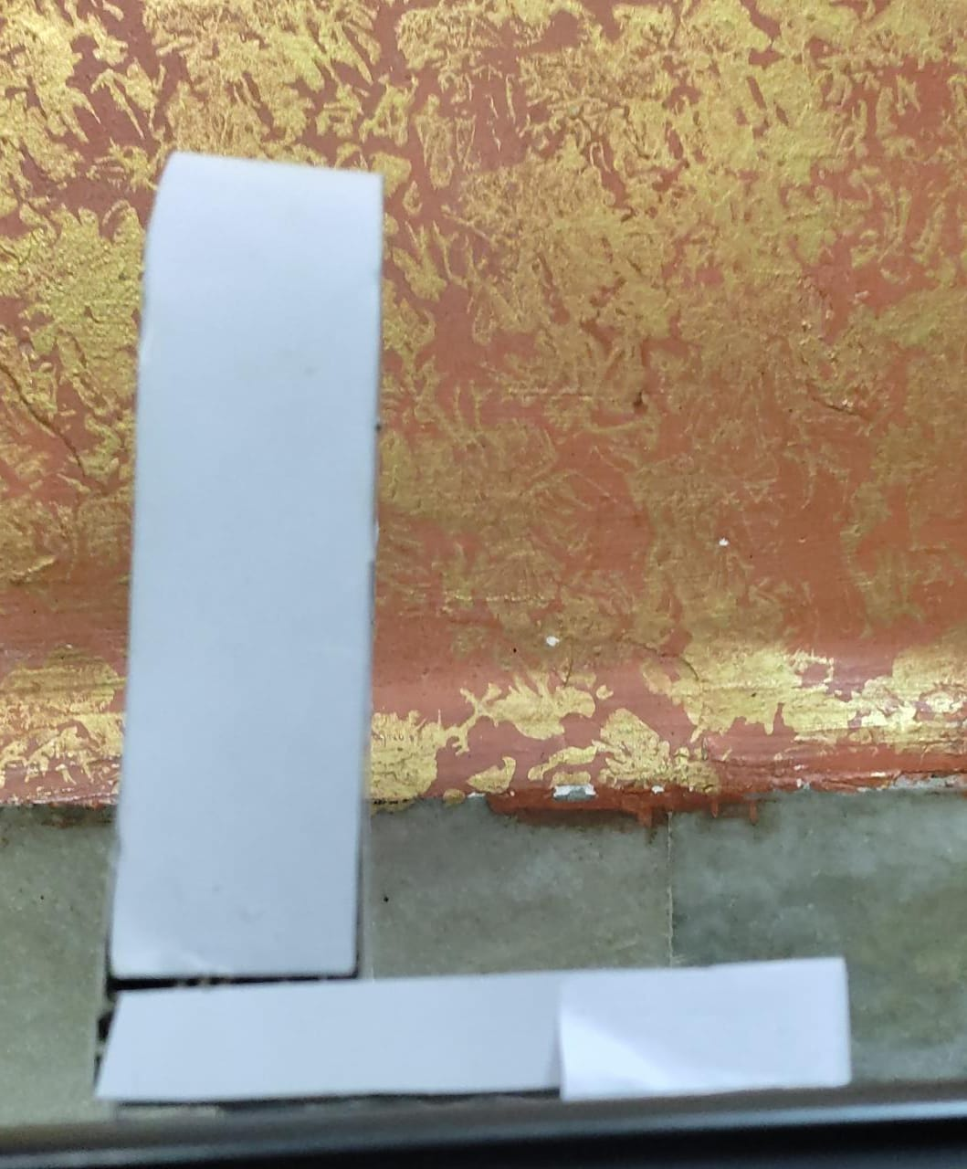
SIDE VIEW

Slide 9
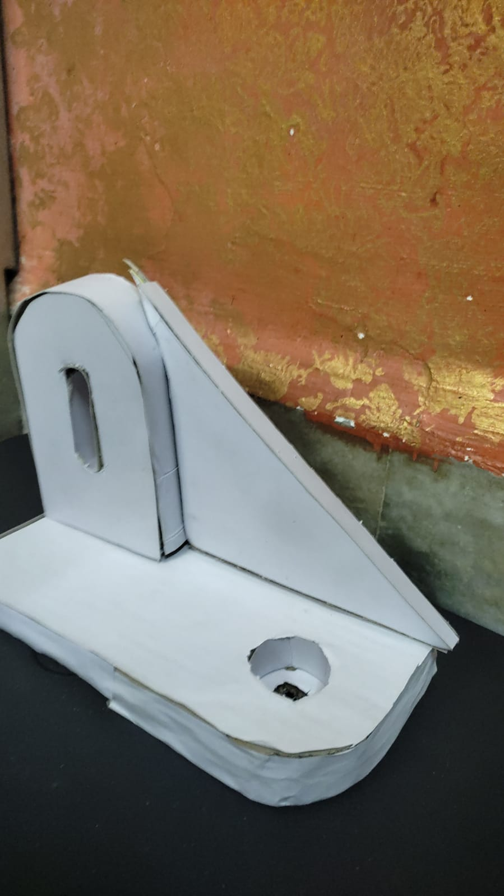
ISOMETRIC VIEW

Slide 10
resources
Sr.no. | Name of resources/Material | Specifications | Quantity
1 | Card board and cello tape | Hard paper which is used to make models and transperent cello tape | 3,1
2 | Scissor and glue | For cutting materials and glue to stick materials | 1,1

Slide 11
Skill Developed and learning outcomes from this micro- project
From this project we have learnt the team work we have learnt how to do any work in unity how to interact with someone. We have learnt how to solve any problems together to , how to face difficulties in any situation and try to sort out the problems . From this project we have learnt that if we will do anything in unity we can do anything.

Slide 12
Benefits of this micro-project
Isometric drawings are very useful for designers- particularly architects , industrial and designers and engineers, as they are ideal for visualisation.
There are a number of other situation in which isometric projection is useful . In way finding system, for eg. In museum or galleries , an isometric wall maps can show visitors where they are in the building what is going on else where and how to get around .

Slide 13
Area of future improvement
From this project we learnt make Isometric models with the helps of this dimensions and in future we can improve our skills by using different resources to make Isometric design and we can draw models digitally also.
In this growing eco-system in the future the new technology Will also come so we can improve our skills better

